Slide 1




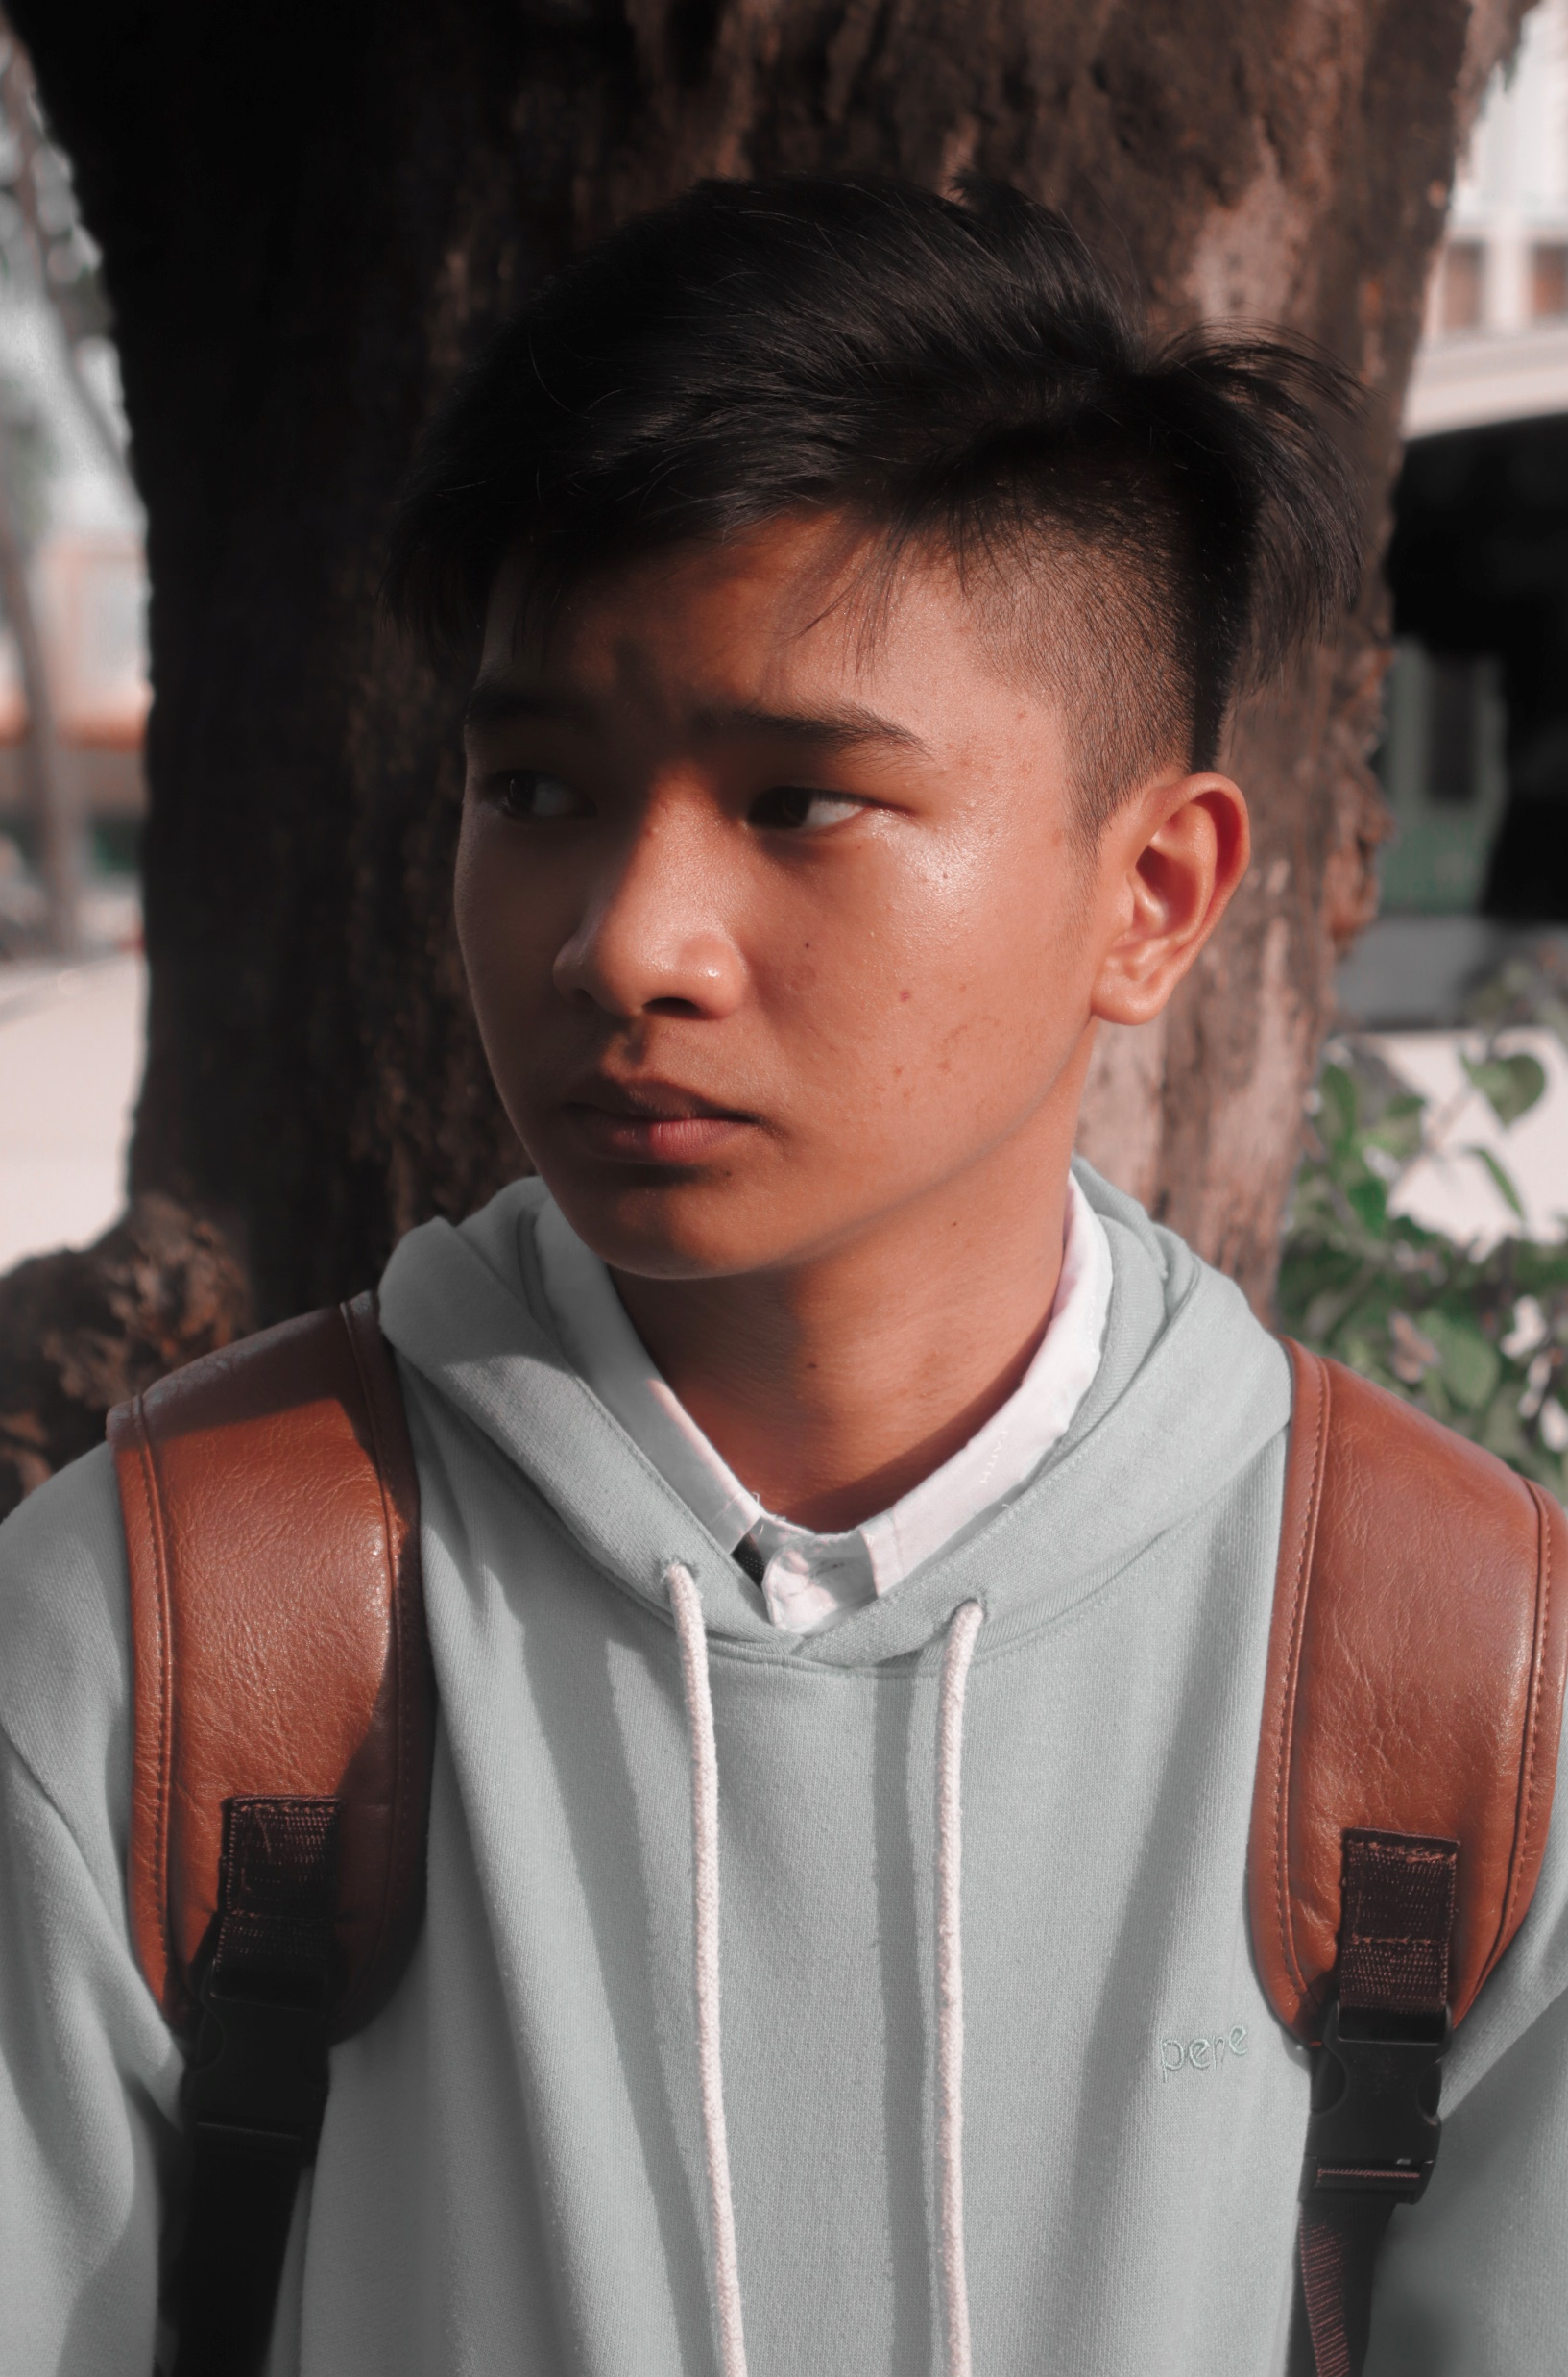
w
Hi! I am
Clark
ayne
Abutal
clark.wayne023@gmail.com
09397406106

Slide 2
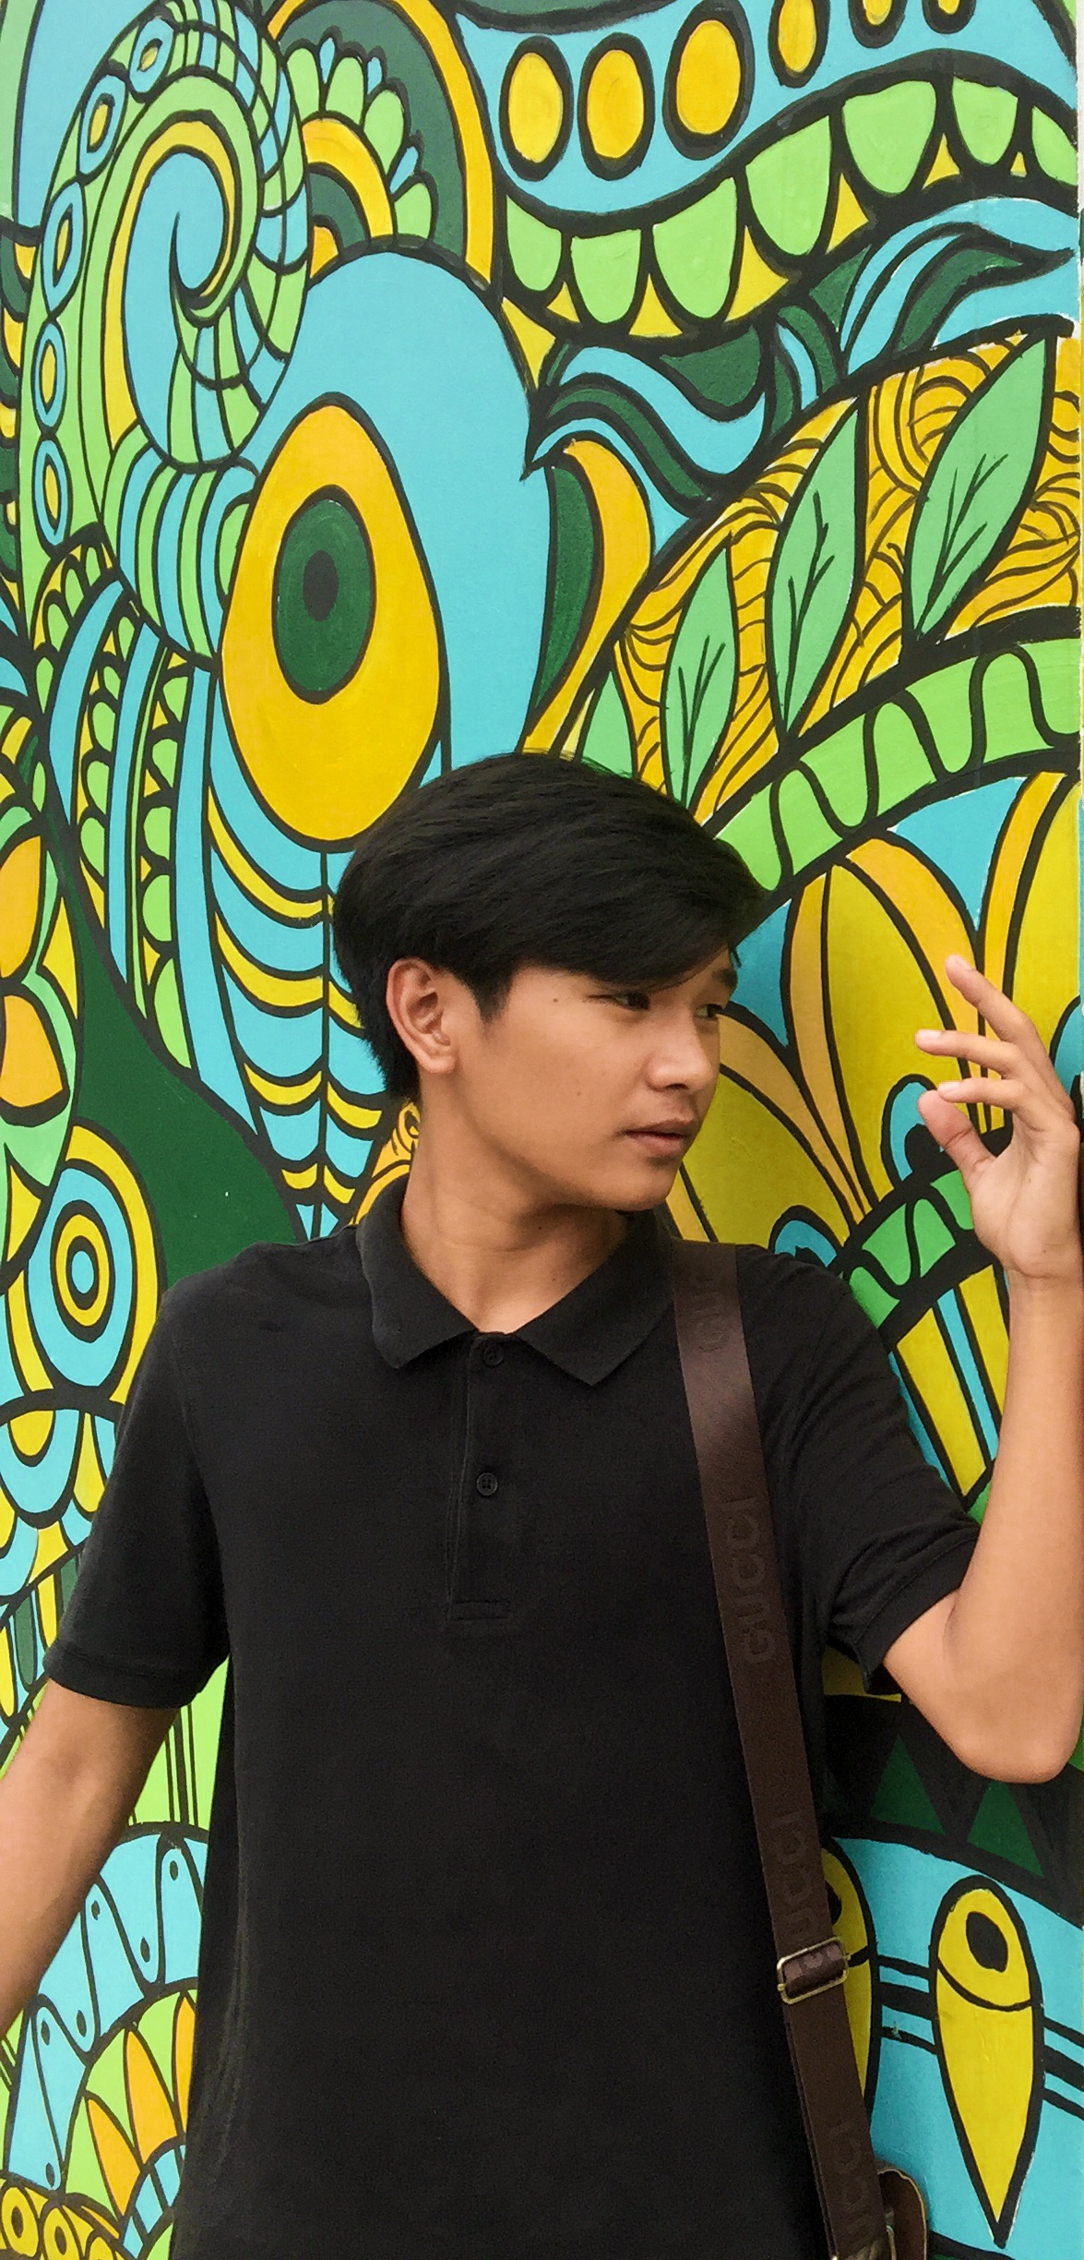
Enthusiastic student who’s quick on his feet. Eager to contribute to team success through hard work, attention to detail, and great work relationships. Motivated to learn, grow, and excel in the digital space.

Slide 3
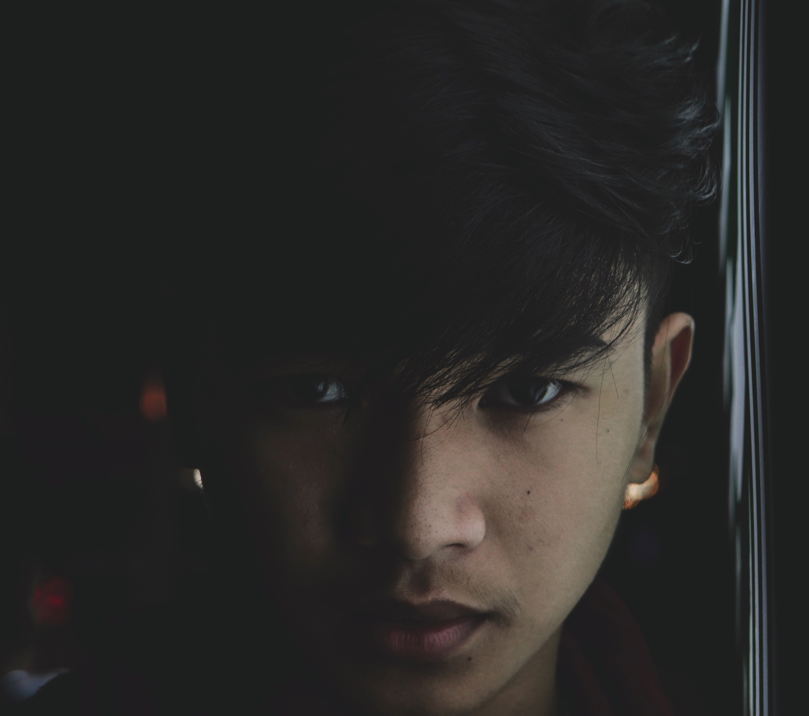
Education
Undergraduate Degree
FAITH Colleges | Bachelor of Science in Computer Science | 2021 - Current
Senior High School Diploma
FAITH Fidelis Senior High | TVL-ICT | 2019-2021 | 94.645 GWA
Junior High School Diploma
Jesus Is Lord Christian School | 2015-2019 |
92.047 GWA
Experience
Graphic Designer
Freelancer | 2020-2021

Slide 4
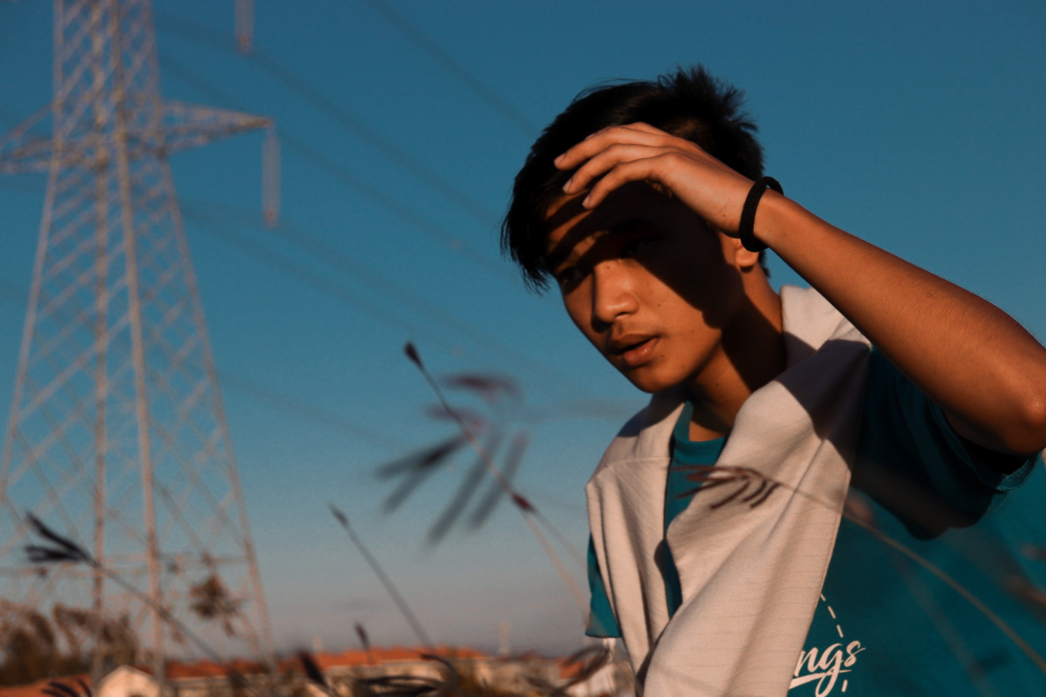
Skill Set
Hard Skills
Soft Skills
Research
Creativity
Photography
Flexibility
Cinematography
Teamwork
Microsoft Office
Problem Solving
Adobe Creative Suite
Time Management
Python & C Language
Conflict Resolution

Slide 5
